Slide 1
Bitwise Operators

Slide 2
Bitwise operators
So far we have studied byte-oriented data types, such as integers and characters
But hardware devices often requires input and output in the form of bits
As we say that C is an ideal choice for programming hardware devices, that is in part due to its Bitwise operators.

Slide 3
Bitwise operators
Operations | Symbol
AND | &
OR | |
XOR | ^
Right shift | >>
Left shift | <<
Complement | ~
Remember logical AND (&&)and logical OR (||) are different from these operators

Slide 4
Bitwise operators
These operators are only applicable on
Integers (signed and unsigned)
Character (signed and unsigned)
The two operands must be of same type
Remember how to number the bits in a datatype
Right to left
7 | 6 | 5 | 4 | 3 | 2 | 1 | 0

Slide 5
AND operator
The AND operation is described below:
The rule is applied to all bits independent of each other
Operand | Operand | Result
0 | 0 | 0
0 | 1 | 0
1 | 0 | 0
1 | 1 | 1

Slide 6
OR operator
Given below:
Operand | Operand | Result
0 | 0 | 0
0 | 1 | 1
1 | 0 | 1
1 | 1 | 1

Slide 7
XOR (^) operator
Returns 1, if only one of the operand is 1
Useful for toggling a bit
An XOR operation applied twice to particular bits in an operand yields the original operand.
Operand | Operand | Result
0 | 0 | 0
0 | 1 | 1
1 | 0 | 1
1 | 1 | 0

Slide 8
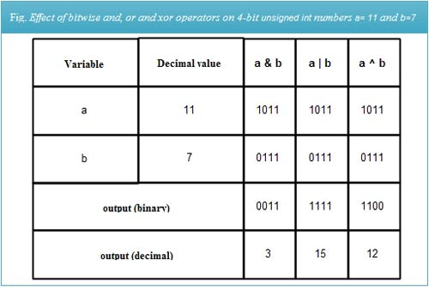
Example

Slide 9
Right Shift (>>) operator
Shift all the bits in the operand towards right
Number of shift can be specified as
Ch >> 3
Bits in ch are shifted three places
What is inserted on left side?
Zero is inserted in case of unsigned char and int
Zero or one in case of signed, depending on the leftmost bit, i.e. zero in case of positive, one in case of negative
Notes:
Zero is inserted in case of unsigned char and int
Zero or one in case of signed, depending on the leftmost bit, i.e. zero in case of positive, one in case of negative

Slide 10
Hexadecimal to Binary conversion

Slide 11
Left Shift (<<) operator
Shifts the bits towards left
Right side is always inserted with 0s

Slide 12
Bitwise complement (~) operator
Inverts all the bits in an operand
Complementing the number twice also yields the same result.

Slide 13
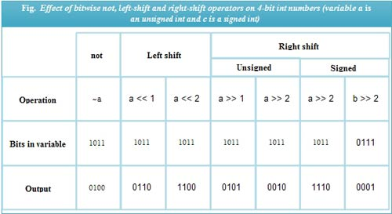
Example

Slide 14
Show the effects of bitwise operators using memory map packing multiple infos in one integer using shift operator

Slide 15
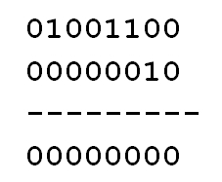
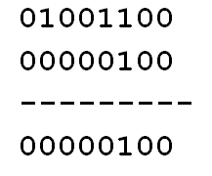
AND usage example
Reading a specific bit of a variable using AND operator, e.g.,
Variable binary
Mask binary
Checking 3rd bit from right
Checking 2nd bit from right
Notes:
Exercise: Read and print the value of each bit of a variable using & operator
- Check whether a number is even or odd

Slide 16
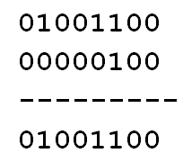
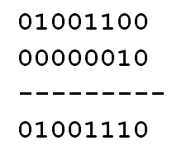
OR usage example
Setting a specific bit of a variable to 1 using OR operator, e.g.,
Variable binary
Mask binary
Setting 3rd bit to 1 from right
Setting 2nd bit to 1 from right
The targeted bit will be set to 1, irrespective if its value
Notes:
Exercise: If the 5th bit is 1, set the 15th bit to 1 as well

Slide 17
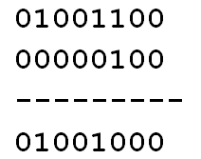
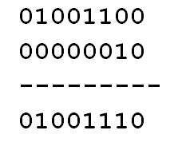
XOR usage example
Inverting a specific bit of a variable using XOR operator, e.g.,
Variable binary
Mask binary
Inverting 3rd bit from right
Inverting 2nd bit from right
Notes:
Exercise: If the 5th bit is 1, invert the 15th bit

